Slide 1
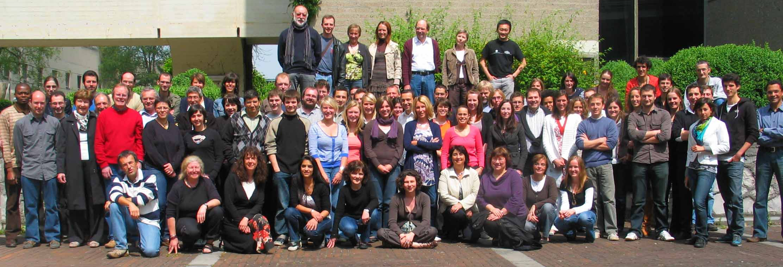
Centre for Protein Engineering: 142 members
Prof. B. Joris : Director
Academics and Senior Scientists : 12
PhDs : 27
PhD students 41
Master Students : 12
Bachelor Students : 38
Technicians : 11
Secretaries : 2

Slide 2
Main research units
Enzymology & Protein folding
Prof A. Matagne and Dr M. Dumoulin
Bacterial diversity, physiology
and genetics
Biological macromolecules
and Biochemistry
Prof B. Joris, Dr C. Duez, Dr S. Rigali, Dr M. Terrak and Dr A. Wilmotte
Prof M. Galleni and Dr G. Feller
Crystallography of Biological Macromolecules
Applied quantum chemistry
Prof P. Charlier
Dr G. Dive

Slide 3
1 Bio-robot model 9600
2 DNA sequencers: 1 ALF model (Pharmacia) and 1 Li-Cor Gene readir 4200
1 Gene Pulser electroporator
Several PCR apparatus including: 1 MJ Mini Real Time Quantitative PCR PTC0148
1 Nanovue
Genetic engineering and molecular biology
Major Equipments
Green algae cultures
1 Versatile environment test chamber
Imaging
1 Axio Imager Z1 fluorescent microscope
1 camera for digitalisation of images
1 CKX 31 inversed microscope (
1 DMLB2 microscope
1 Phase contrast microscope
1 Molecular Imager FX system
1 SZ-6 PHOTO binocular microscope
1 Typhoon Trio+ scanner
Analytical studies
1 BIAcoreX
1 Circular Dichroism spectrophotometer J-810
2 2D-electrophoresis
2 DGGE electrophoresis
3 Fluorimeters:
2 HPLC systems
2 Microcalorimeters: MCS ITC/DSC and VP-DSC
2 Microplate readers
1 Procise 492 N-terminus amino acid sequencer
2 Quenched-flow
1 Rapid filtration system
10spectrophotometers UV/Vis
2 Stopped-flow apparatus:
Crystallography
1 Cryogenic AD41 cryosystem
4 Graphic-PC stations
1 Imaging Plate Marresearch IPmar345
with a RU200B rotating anode

Slide 4
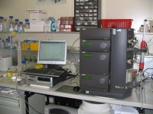
Platform: Protein Production and Purification
Contact: Dr. A. Brans (abrans@ulg.ac.be)
Provides expertise and services in the areas of microbial fermentation , protein and metabolite purification
Recombinant expression systems
E.coli, Bacillus, Streptomyces, Yeast (Aspergillus, Saccharomyces, Pichia)
Fermentation
Batch, fed-batch, or continuous culture (2, 4, 15, 60 L) Cell or supernatant harvesting : continuous centrifugation
hollow fiber filtration
Protein purification Cell disruption Pilot scale micro- and ultra-filtration Chromatography systems (FPLC, Akta prime, Akta explorer, 2D LC, BioPilot)

Slide 5
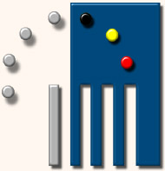
PAI-IAP
Belspo
ProGenosis SA
ZenTech

Slide 6
The metagenomic approach
Moreno Galleni (mgalleni@ulg.ac.be)
Georges Feller (gfeller@ulg.ac.be)
Renaud Berlemont (rberlemont@ulg.ac.be)
Maud Delsaute (maud.delsaute@student.ulg.ac.be), Olivier Spee

Slide 7
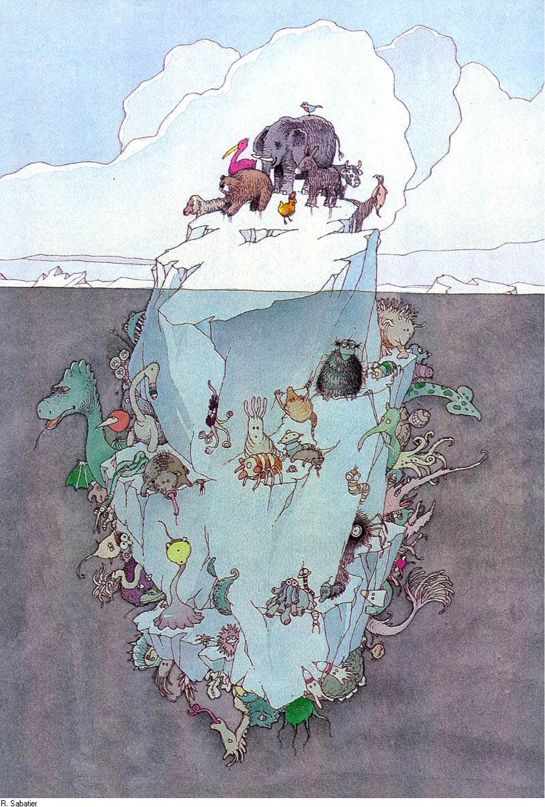
The metagenomic approach
4-6 . 10³⁰ bacteria
1,2 . 10²⁹ Oceans
2,6 . 10²⁹ Soil
3,5 . 10³⁰ Soil (deep)
Microorganisms, and their enzymes, for Biotechnology (e.g. antibiotics, fermentation, expression, bioremediation)
>95% of the bacteria in environment are unable to grow in laboratory conditions

Slide 8
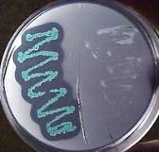
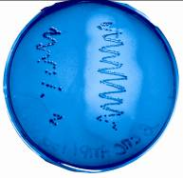
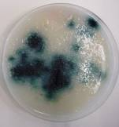
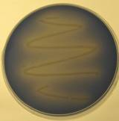
The metagenomic approach
Environmental samples
Direct DNA extraction
Cloning vector :
Plasmids
Cosmids
BACs
Statistical analysis :
Amount of clones
Average insert size
Sequencing …
DNA extraction (no cultivation)
DNA cloning (cultivable hosts)
Activity driven screening
-Oriented
-Recognition of transcription
signals
DNA library analysis
Protease
Cellulase
Indirect DNA extraction
Hosts :
Culturable bacteria
E. coli
-Bacillus
-…
Activity driven Screening
Sequence driven screening
-Oriented
-based on conserved sequences
signatures
New-enzymes
Oxidase
Lipase

Slide 9
The metagenomic approach
Fundamental
science
Applied
research
Phylogeny
Adapation
Diversity
Intellectual propriety ?
Novelty
metagenomic
CIP
Novelty
Specificity
Environmental microbiology
Biophysical properties

Slide 10
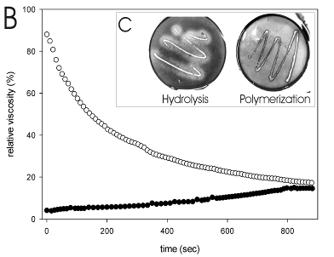
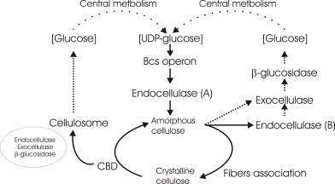
RBcel1
Cellulase for cellulose degradation (biofuel)
RBcel1, high activity on CMC
Cellulases are good transglycosylases
Cellulase for cellulose synthesis
Insights into bacterial cellulose biosynthesis by functional metagenomics on Antarctic soil samples, 2009 Berlemont & Delsaute. ISME J 1-12
Carbohydrate actives enzymes derived from metagenomes: from microbial ecology to enzymology. 2010 Berlemont & Galleni. In « Metagenomics and its Applications in Agriculture, Biomedicine and Environmental Studies » NovaSciences

Slide 11
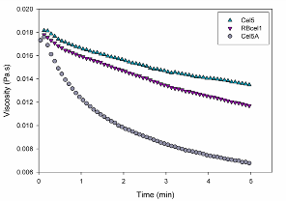
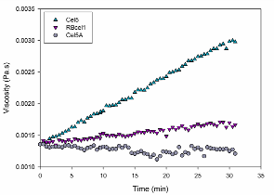
RBcel1
What makes cellulases good transglycosylases ?
What makes transglycosylases good hydrolsases ?
selection of « true » hydrolytic cellulases selection of « true « transglycosylases
Comparison
Exchange
(inhibition by the product ?)
RBcel1
Transglycosylation
Hydrolysis
Improve the enzymatic cellulose
degradation/production
RBcel1

