Slide 1


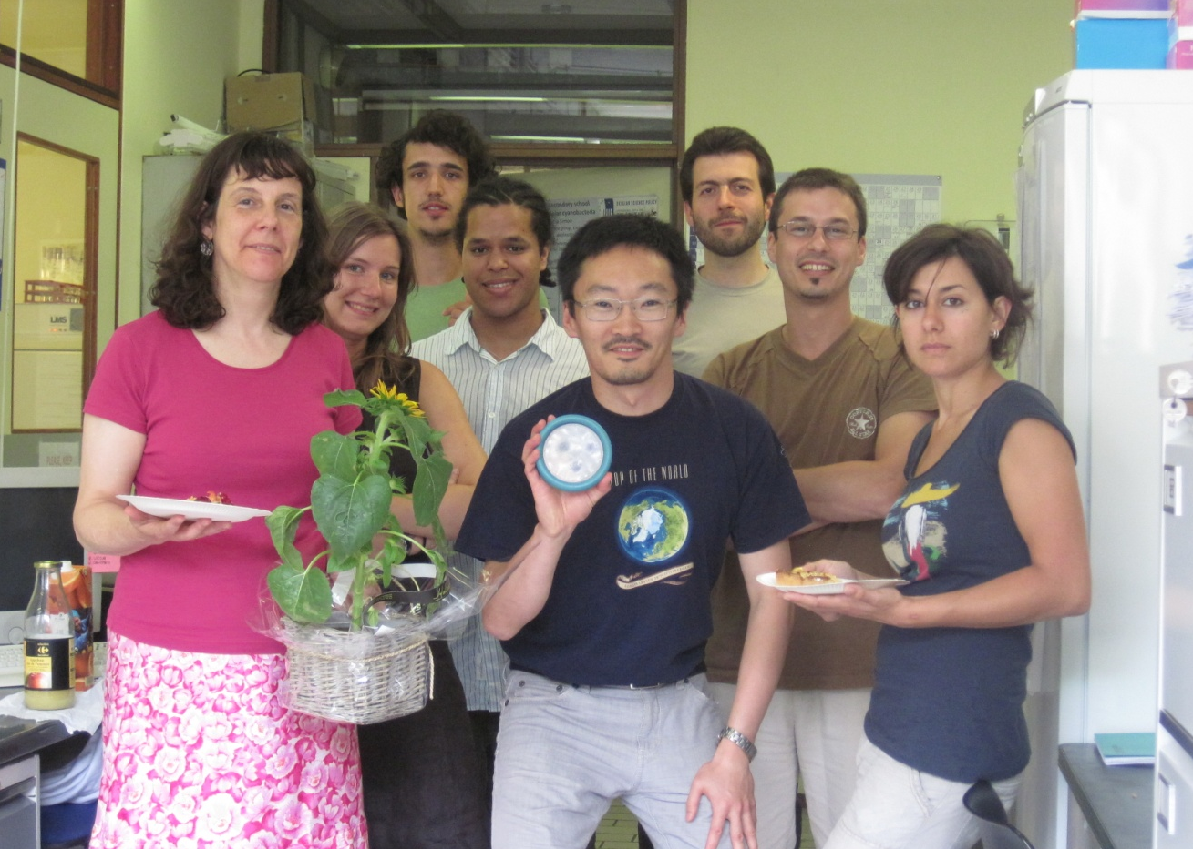
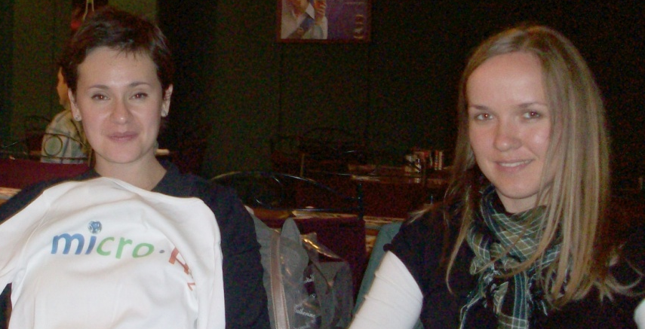
The cyanobacteria group (CIP)
Laboratory of bacterial physiology and gggggggggggggggggggggg genetics
Dr Annick Wilmotte
Dr Zorigto Namsaraev
Rafael Fernandez Carazo
Yannick Lara
Pedro De Carvalho Maalouf
Marie-José Mano
Alexandre Lambion
Marine Renard
Dr Olga Savichtcheva
Magda Calusinska

Slide 2
Molecular taxonomy and evolution of cyanobacteria
I. The Centre for Protein Engineering
II. Earlier collaborations with SCK.CEN
A) Basis: Long-term interest for the diversity of the genus Arthrospira
B) Collaborations with SCK.CEN about MELiSSA
III. Molecular diversity of cyanobacteria in diverse environments
A) B-BLOOMS: toxic cyanobacterial blooms in Belgium
B) Discovery of the genotypic diversity of the cyanobacteria in the region of the New Belgian Antarctic Research Station ‘Princess Elisabeth’
C) BCCM collection of cyanobacterial strains from the Antarctic and Arctic
IV. Molecular ecology of Hydrogen production by Clostridia

Slide 3
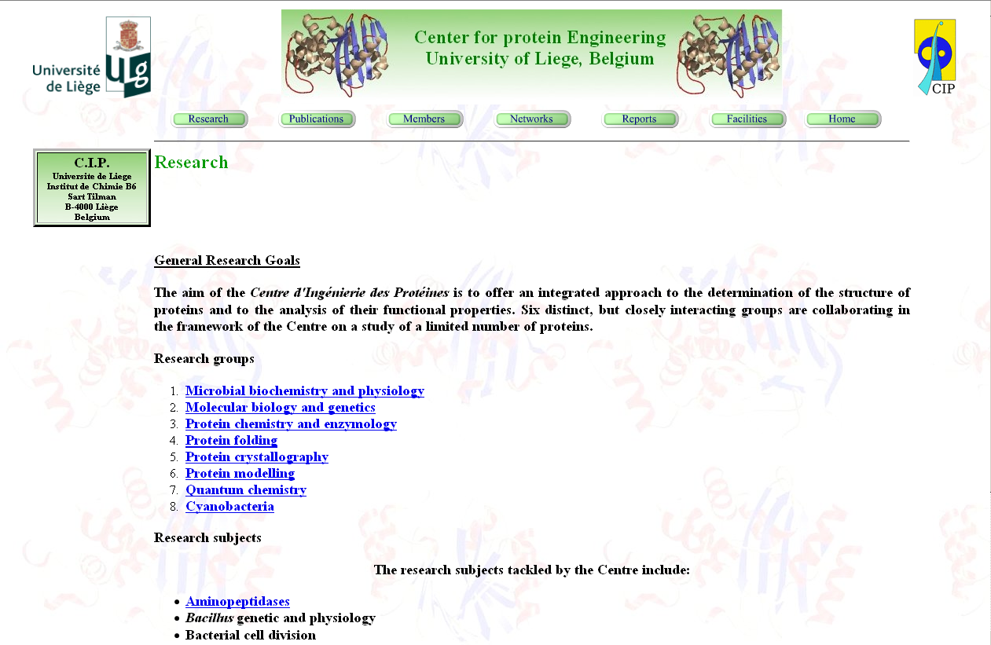
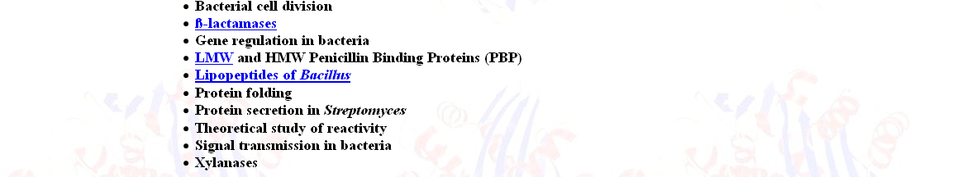
I. The Centre for Protein Engineering
http://www.cip.ulg.ac.be/

Slide 4
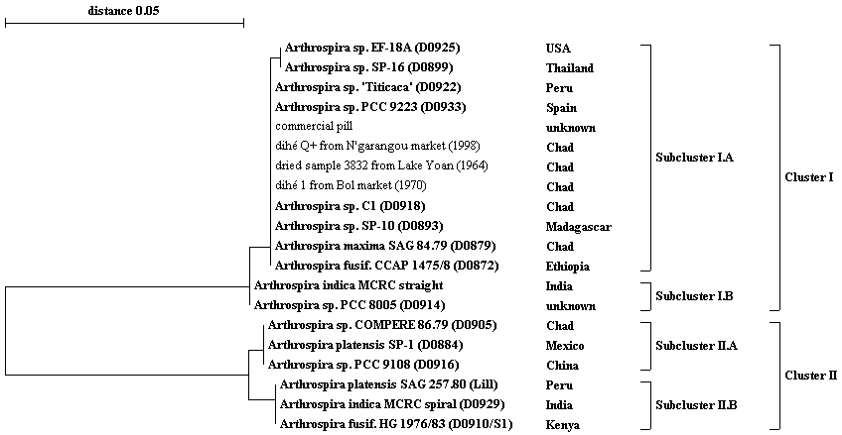
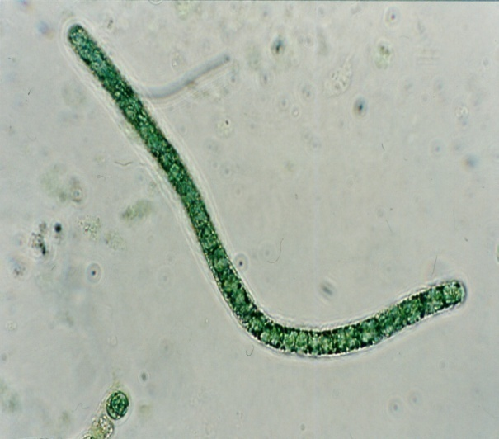
II. Earlier collaborations with SCK.CEN
A) Basis: Long-term interest for the diversity of the genus Arthrospira
1) The first paper proving that the genera Spirulina and Arthrospira are different , on the basis of their 16S rRNA
2) two papers dealing with the diversity of 54 strains from 4 continents, based on a molecular taxonomy marker (ITS, spacer between the genes coding for 16S and 23S rRNA). The ITS was surprinsingly conserved, even for strains of different geographic origins.
ITS-tree of 16 representative Arthrospira strains and old dried samples (up to 40 years old)
Strain PCC 8005

Slide 5
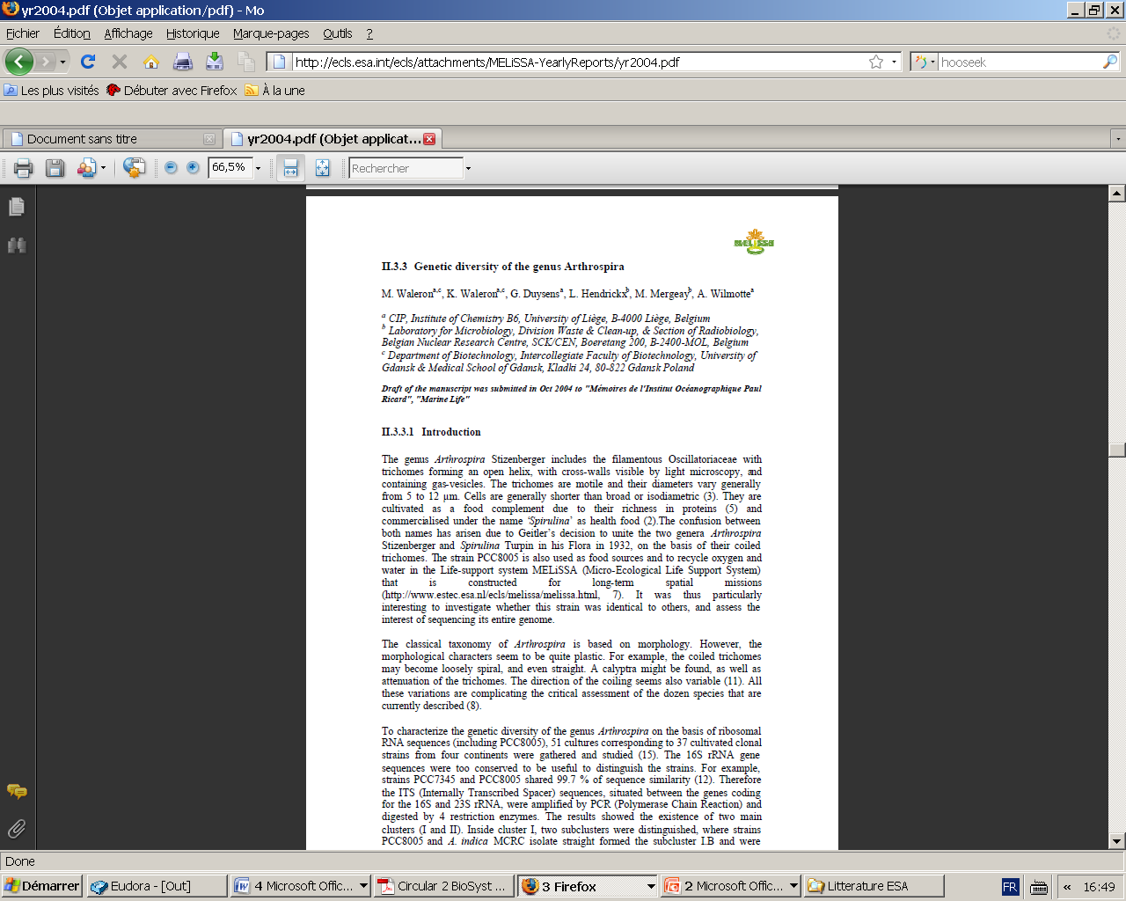
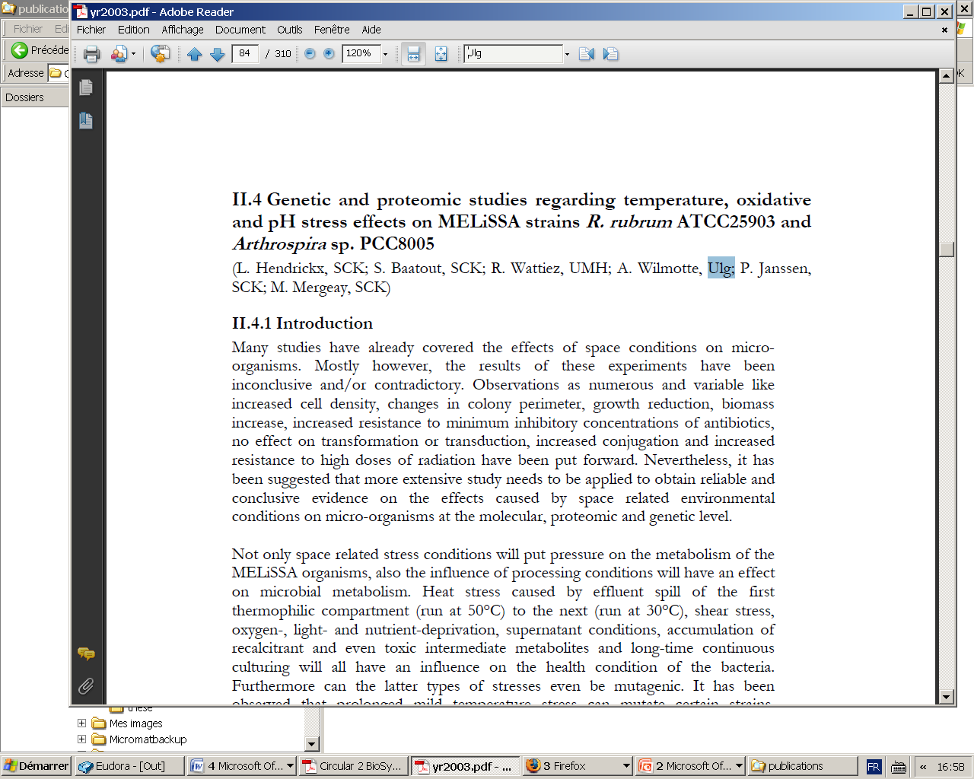
B) Collaborations with SCK.CEN about MELiSSA
Dr Max Mergeay & Natalie Leys, Laboratory of Molecular and Cellular Biology, Unit of Microbiology, Institute for Health, Environment and Safety
2002-4: MELGEN1
  Genetic stability of strain PCC8005, fingerprinting with AFLP, ‘Genome Watch’
2005-9: AWM fellowship to Nicolas Morin
  Genome of Arthrospira PCC8005 and effects of space-related stress
2008-9: MELGEN2 (1 year PhD fellowship to Karin Vauchel)
  Genomic stability of Rhodospirillum rubrum S1
  Genomic fingerprints with repeats: effects of high light intensities
OUTPUTS: REPORTS
MELiSSA Annual report 2003
MELiSSA Annual report 2004

Slide 6
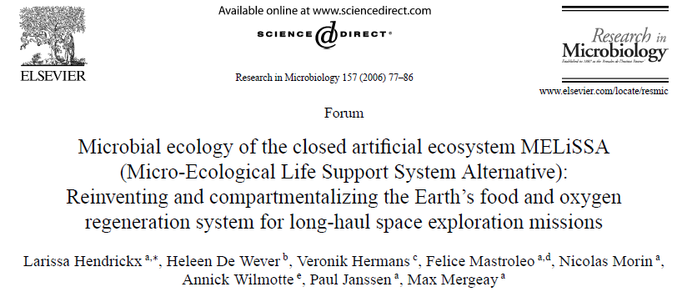
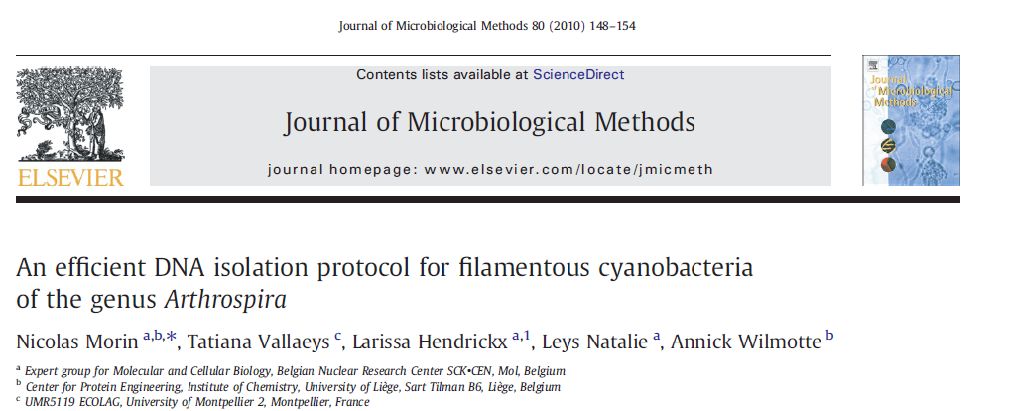
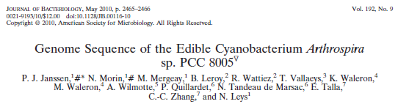
OUTPUTS: Common abstracts and publications

Slide 7
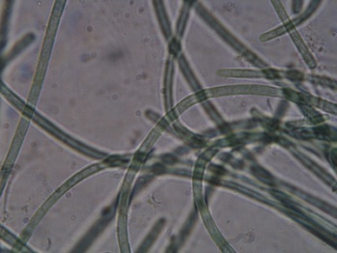
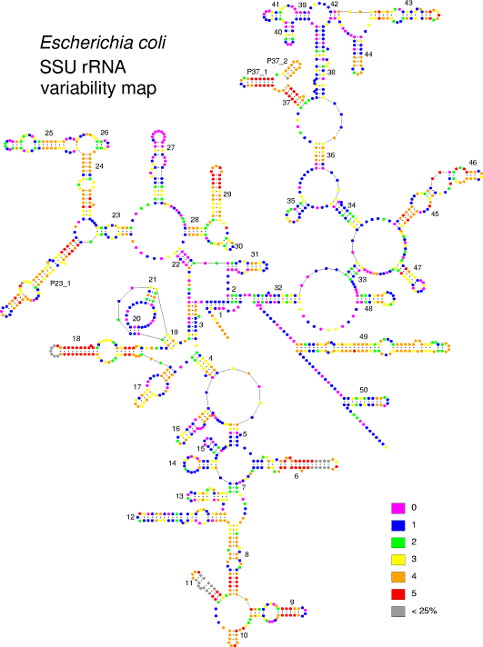
III. Molecular diversity of cyanobacteria in diverse environments
Microscopic organisms, with simple and variable morphologies → microscopic observation is not adequate to study their diversity and evolution
Use of molecular taxonomic markers, as the ribosomal RNA sequences, spacers between 16S and 23S rRNA genes, house-keeping genes, Multiple Locus Sequence Analysis
Techniques: PCR, Q-RT PCR, Whole Genome Amplification, Denaturating Gradient Gel Electrophoresis, Clone libraries, Genomic fingerprints, Whole genome Amplification, Bioinformatics
Soon: next-generation sequencing 454
→ To solve questions on their phylogeny, diversity, ecological and geographical distribution, their potential for toxin production, their genetic stability

Slide 8
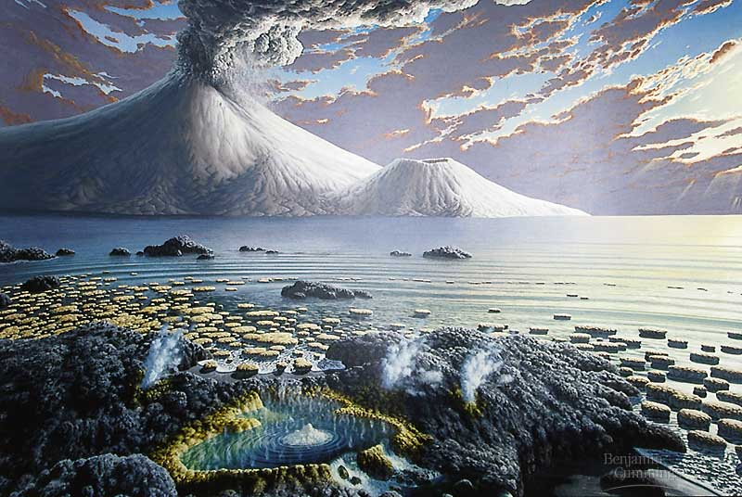
III. Molecular diversity of cyanobacteria in diverse environments
Certain cyanobacterial taxa
- very resistant to dessication/radiation
UV protection mechanisms
tolerate high or low temperatures
tolerate high or low light intensities
tolerate high or low salinities
certain metabolic flexibility (anoxygenic photosynthesis, heterotrophic capacity, nutrient scavenging)
N₂ fixation
Limits? Low pH!

Slide 9


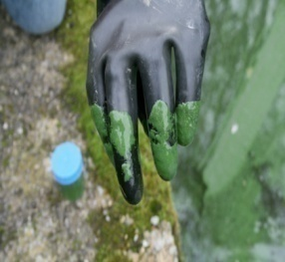
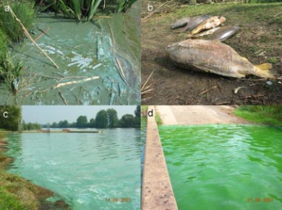
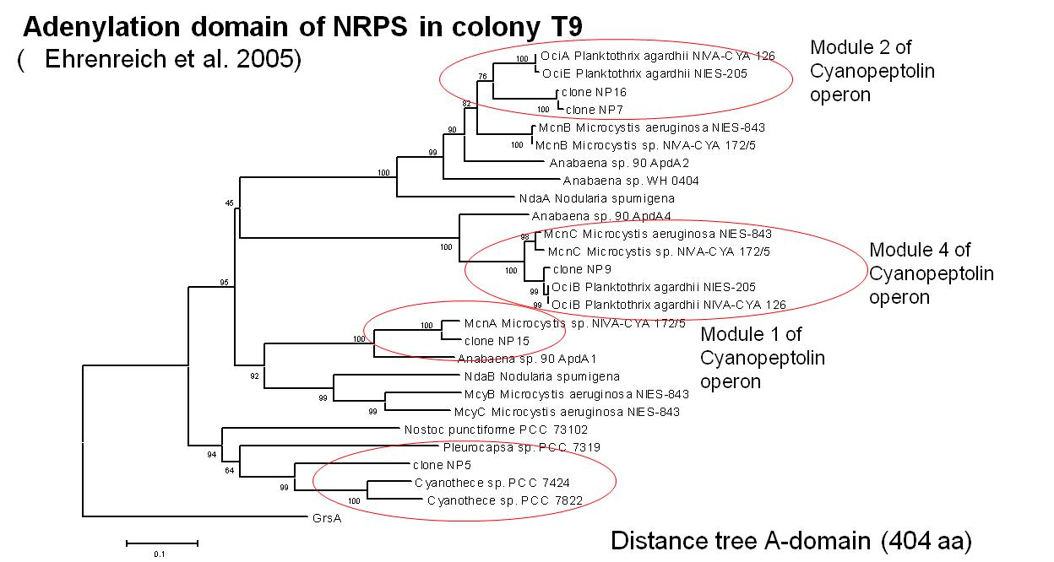
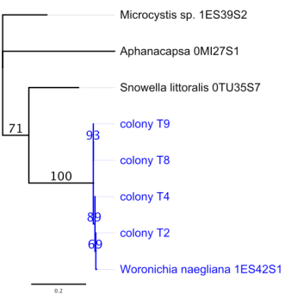
A) B-BLOOMS: toxic cyanobacterial blooms in Belgium
In Belgium, toxic cyanobacterial blooms were observed in Flanders , Wallonia and Brussels. Microcystin concentrations exceded the threshold value of 25 ng/L (French directive for recreation waters)
Techniques used:
Molecular diversity: DGGE of 16S rRNA/ITS, Clone libraries, Real time QPCR, Whole Genome Amplification on ‘single colonies’
Toxigenicity: PCR for the operons synthetizing the toxins (when known)
Single colonies
PCR to detect operons for synthesis of secondary metabolites (NRPS, PKS)
Identification Woronichinia

Slide 10
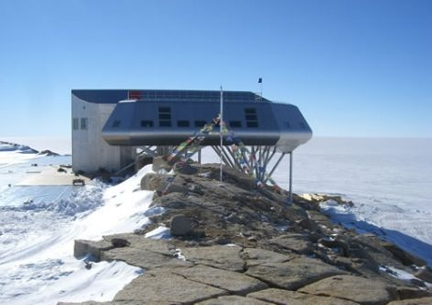



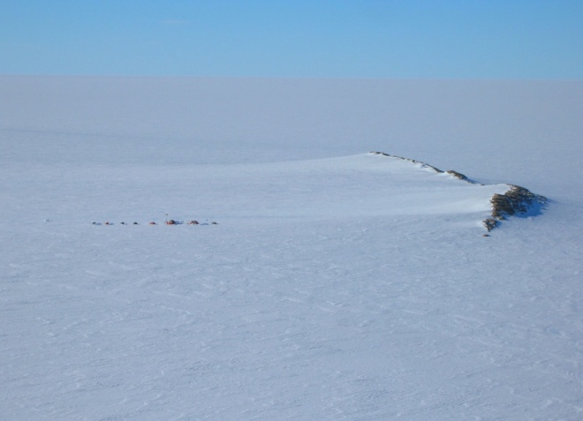
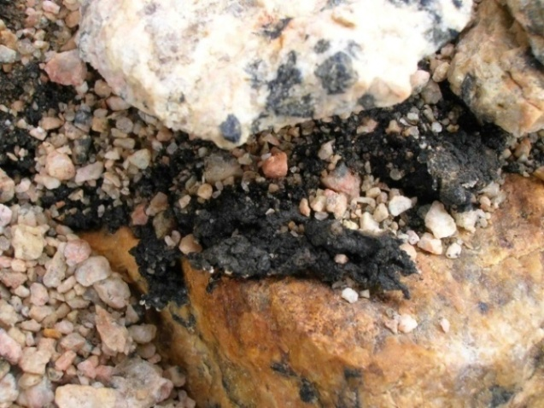
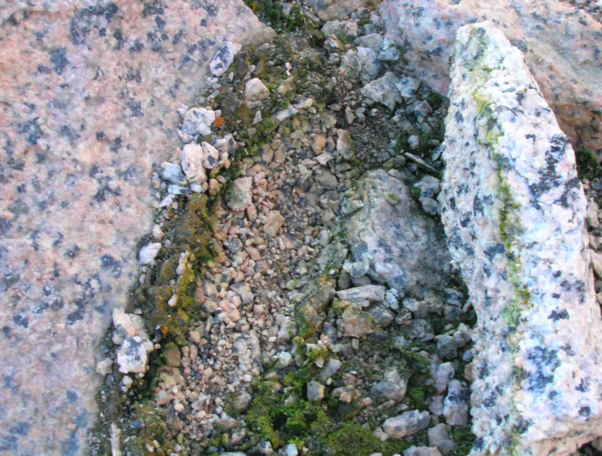
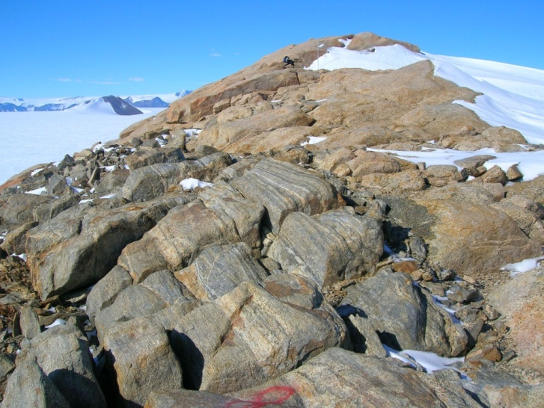
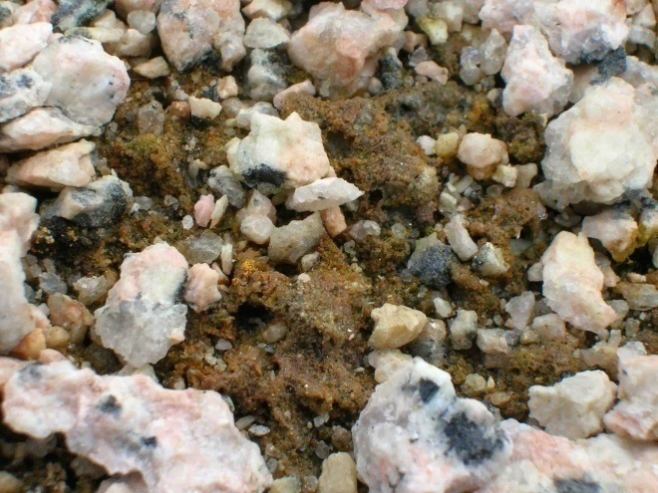
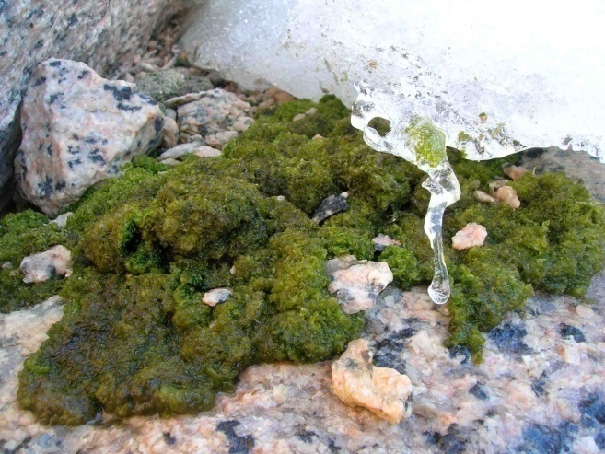
Belspo
B) Discovery of the genotypic diversity of the cyanobacteria in the region of Utsteinen in Antarctica (New Belgian Research Station Princess Elisabeth)
Ridge
Proxy for life on Mars?
Collaboration with Prof. Javaux on the search for the signatures of Life

Slide 11
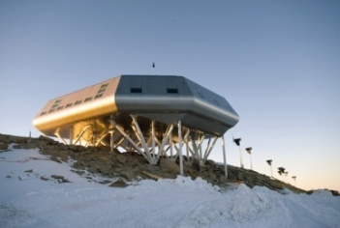
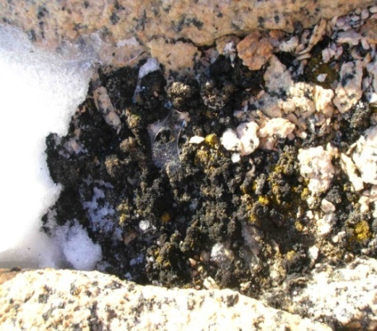
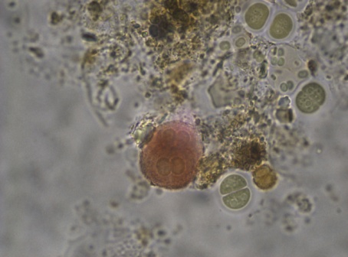
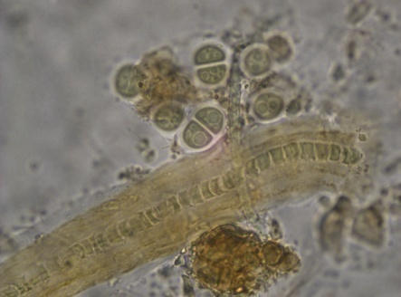
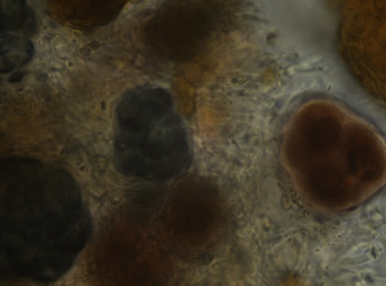
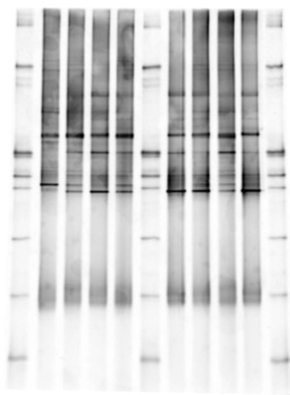
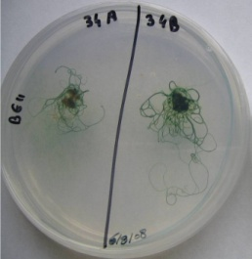
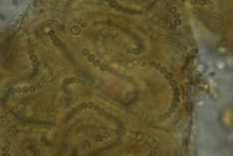
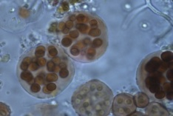
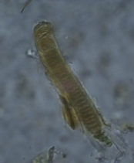
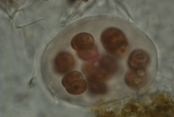
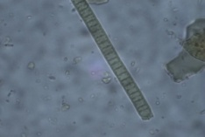
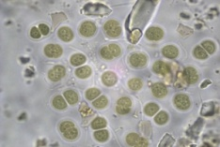
Diversity of cyanobacteria in the region of the Princess Elisabeth station
Characterisation of the community
Characterisation of isolated
strains
DGGE gel
Leptolyngbya molecular diversity

Slide 12

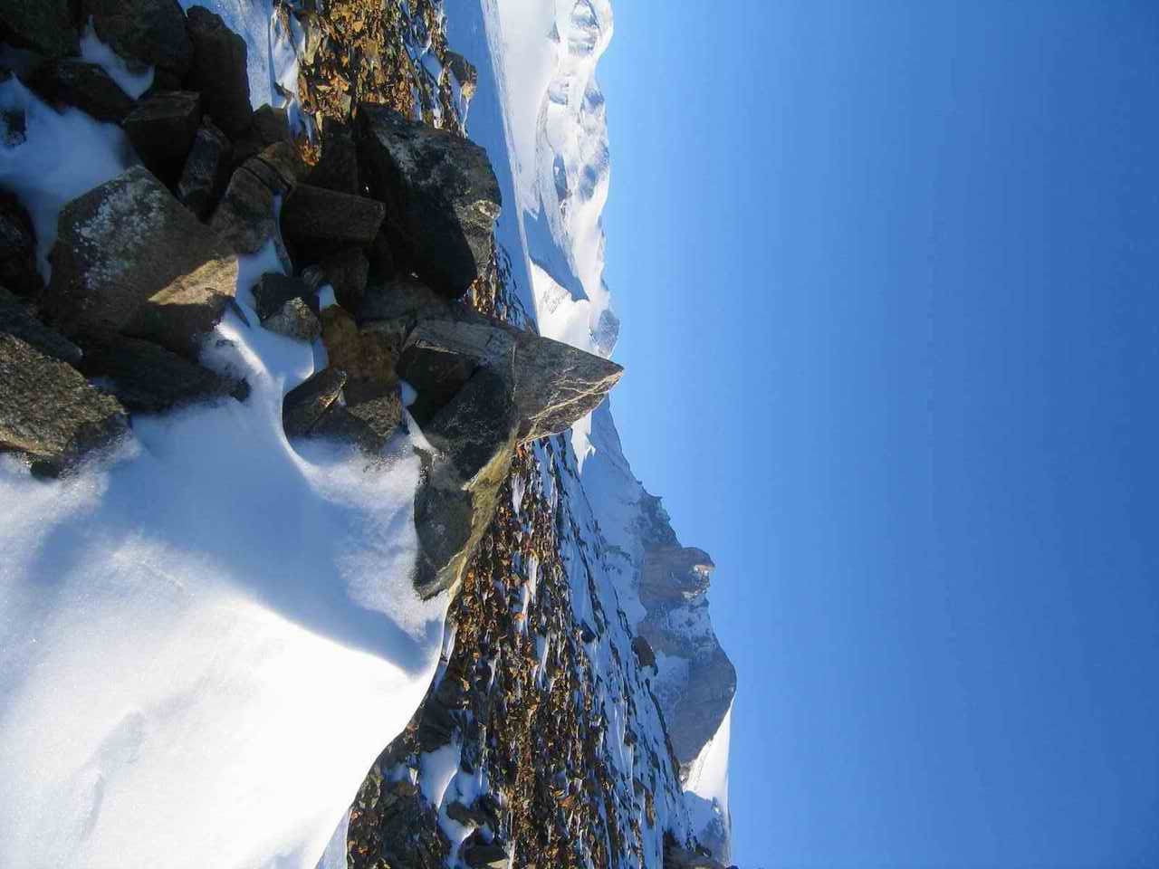
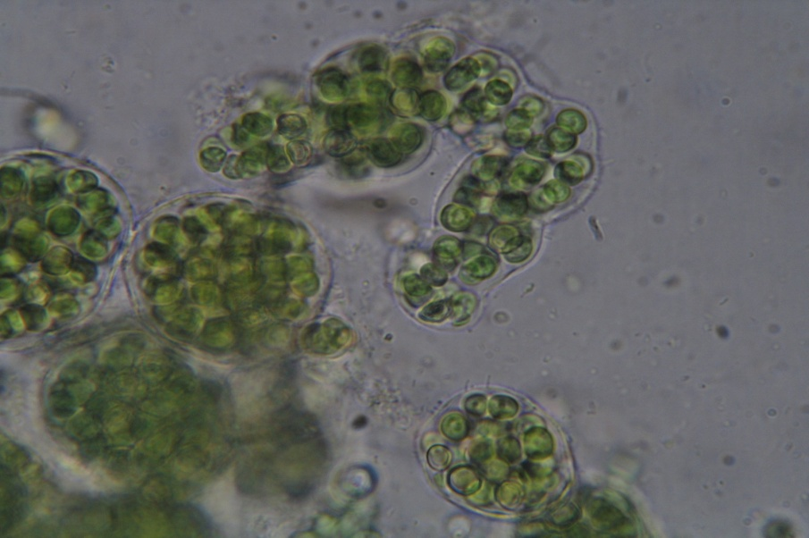
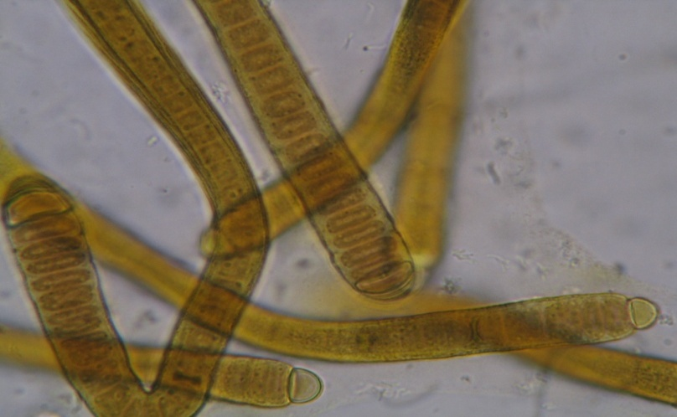

C) A BCCM collection of cyanobacterial strains from the Antarctic and Arctic
The Belgian Co-ordinated Collections of Micro-organisms has started an integration project for new collections, among which polar cyanobacteria (http://bccm.belspo.be/projects/programme2005-2008/c30014/). 125 unicyanobacterial strains are now included (http://www.cip.ulg.ac.be/newsite/pages/collectioncyano.php).
Contact: Annick Wilmotte (awilmotte@ulg.ac.be) and Marine Renard (mrenard@ulg.ac.be), Centre for Protein Engineering, Institute of Chemistry B6, 4000 Liège, Belgium. Tel: 32 04 366 33 87, FAX: 32 4 366 33 64

Slide 13


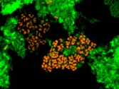
Molecular ecology of Hydrogen production by Clostridia
(COLLABORATION Centre Wallon Biotechnologie Industrielle)
1) Use of molecular ecology techniques to monitor the consortia of Clostridia producing H₂, and their activities in the bioreactors
Techniques:
FISH (Fluorescent In Situ Hybridisation)
Q RT-PCR (Quantitative PCR Real-Time)
2) Study of the metabolic activity of the strains and expression of the different hydrogenases found by bioinformatic study of genomes
Quantification of mRNA from the hydrogenases of two strains

